Slide 1
Tool for building and working with automata
AUTHOR: Lionte Bogdan-Andrei
COORDINATOR: Lect. Dr. mihai alex moruz

Slide 2
TABLE OF CONTENTS
MOTIVATION
ARCHITECTURE
FUNCTIONALITIES
DEMO
CONCLUSIONS

Slide 3
MOTIVATION
COMPILERS
REGULAR EXPRESSIONS
PROBABILITIES
Notes:
Automata are intensively used in the development of software applications. For example, they are used in compilers.
Lexers use automata to construct tokens while parsing the characters in a source file.
Regular expressions are also very used. They are compiled into an NFA in order to efficiently match words from a specific alphabet.
Markov chains are represented using automata. The transitions in such automata are probabilities. Markov chains are used for weather forecasting.

Slide 4
ARCHITECTURE

Slide 5
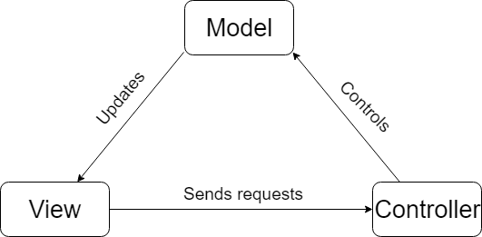
MVC
Notes:
MVC is an architecture which stands for model view controller. The user interacts with GUI elements like buttons and the controllers capture these interactions, modifying the model. The model is represented by the automaton which contains states and transitions. The views are updated after the controller changed the model.

Slide 6
Java fx
MODERN LOOK AND FEEL
WORKS WELL WITH MVC
SCENE BUILDER
Notes:
The application is written in JavaFX, a platform for creating desktop applications. I chose javafx over swing because it has a more modern look and feel, works better with MVC architecture thanks to the .fxml files for creating the views. The interface is easier to build with the scene builder integrated in many IDEs.

Slide 7
FUNCTIONALITIES

Slide 8
BUILD AUTOMATON
ADD SYMBOLS TO ALPHABET
CREATE TRANSITION
DELETE STATE
Notes:
An automaton can be built step by step through the interface. The first step is to add symbols to the alphabet. Then we can start creating states and transitions. When we create a new transition we have to specify the source and destination state, their types and the transition symbol. The types can be regular, initial, final. Transition symbol will be selected from a dropdown containing all the symbols that we added. We can also delete states. When we delete a state, all the transitions related to that state are deleted.

Slide 9
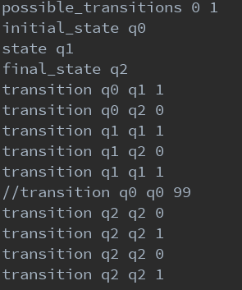
SAVE & LOAD
POSSIBLE_TRANSITIONS
STATE
INITIAL_STATE
FINAL_STATE
TRANSITION
Notes:
Once built, an automaton can be saved to a file and then loaded any time. The good thing about it is that it is not just a binary serialization. The format is actually readable and can be easily modified by users.

Slide 10
Drawing arcs
PATH
MOVETO
ARCTO
LINETO
Notes:
Arc are javafx Path elements. They start with a moveTo element and intermediate points can be added. The path will go through those points. If the point is an arcTo, the path will be arched, if it is a lineTo, it will be straight.

Slide 11
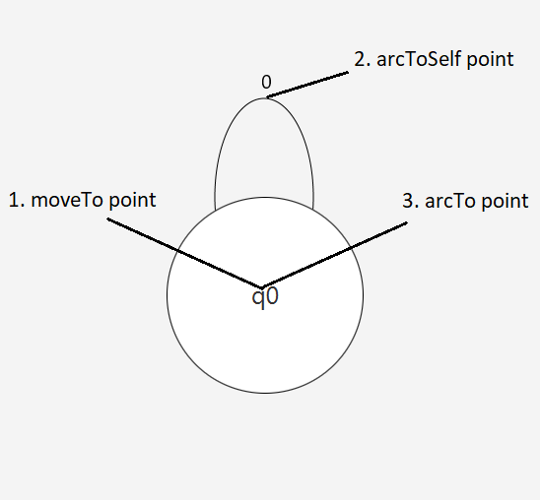
DRAWING SELF TRANSITION
Notes:
Self transition arcs are created with a path which consists of 3 points. The first one is the moveTo in the middle of the state, the second one is an arcTo just above the state, and the last one is an arcTo in the middle of the state.

Slide 12
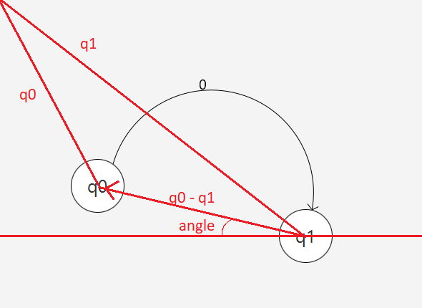
Drawing arcs
Notes:
In had to place the end of the arc exactly on the edge of the state. I knew that the point had to be away from the center at a distance equal to the radius. Then I had to find the direction. The direction to the other state was given by the angle between the two states with respect to the horizontal axis. I had to add 90 degrees to that angle so that the arc will end above the state.
Then I found the required point by adding sin * radius and cos * radius to the coordinates of the middle of the state.

Slide 13
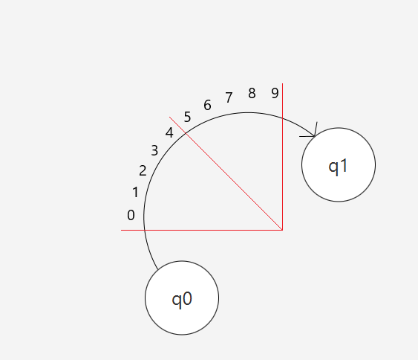
DRAWING SYMBOLS
Notes:
Drawing symbols on arcs to self was pretty easy because I could use only one javaFX Text object containing all the transition symbols and place it above the state.
Drawing symbols on regular arcs was more difficult. Again I found the angle between the horizontal axis and the difference of the vectors corresponding to the two states. I added 90 degrees to that angle so the direction will be through the middle point of the arc. Then I got the direction of the first symbol by subtracting half of the angle along which the symbols span. Then I kept placing the symbols and increasing the angle by an amount which depends on the number of states. So if there was a lower number of states, the angle would be increased by a greater value.

Slide 14
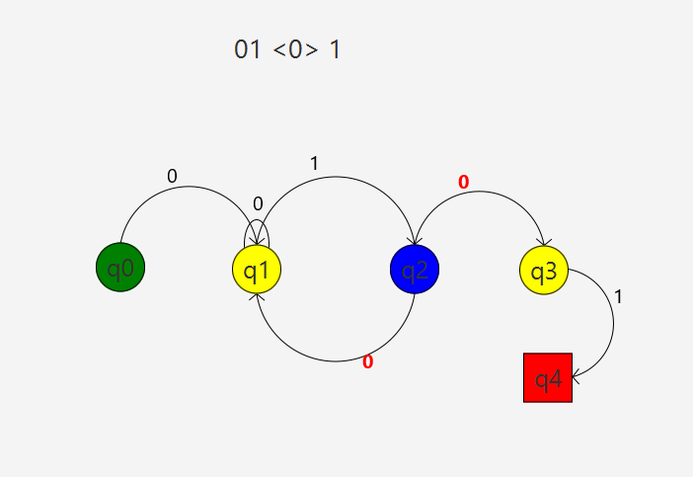
parsing
Notes:
Another feature is parsing words. Once the parsing starts the current state will be colored with blue, reachable states will be colored in yellow and available transition symbol will turn red and bold. We advance by clicking the state we want to go to next. These colors can be changed from a settings file. If we reached the end of the word and we are in a final state a popup will show up saying that the parsing was successful.

Slide 15
Dfa minimization
REDUCE COMPLEXITY
INCREASE EXECUTION SPEED
Notes:
I use a two dimensional array in order to keep track of separability between each pair of states.
First, I initialize the separable array. Two states are separable if one is final and one non final.
δ(qi, a) is the state we reach when we transition from qi with a.
//if there exists a such that δ(qi, a) sep δ(qj, a) it means qi and qj are separable and so are all the states that depend on them. I get all the states that depend on them from another array.
Then I merge unseparable states.

Slide 16
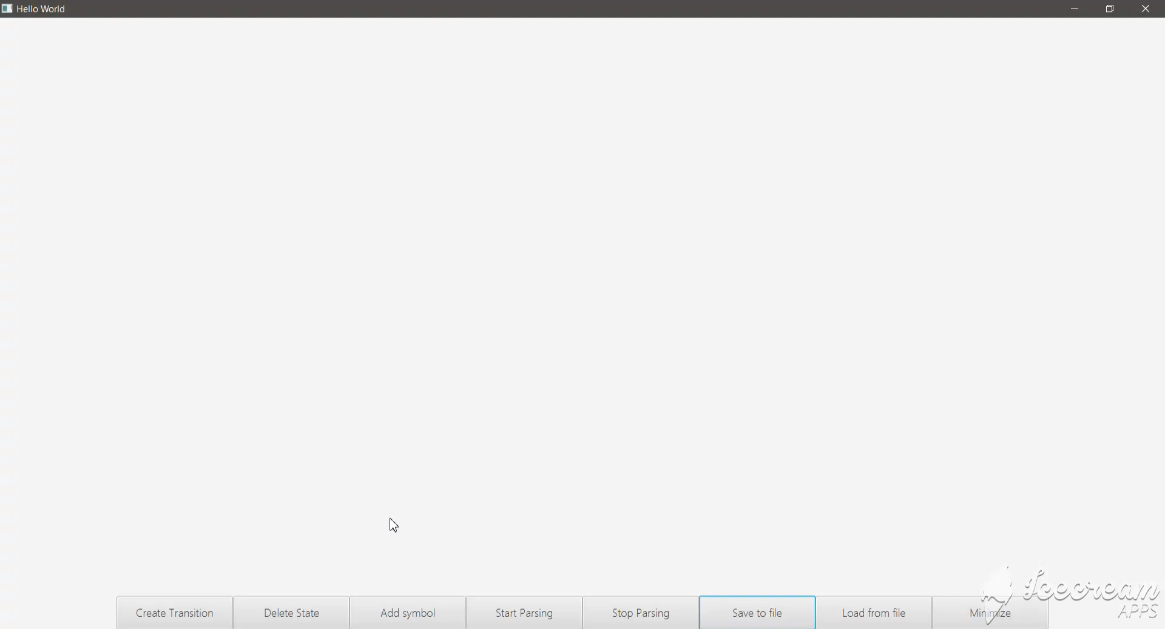
demo

Slide 17
conclusions

Slide 18
Thank you

